Slide 1
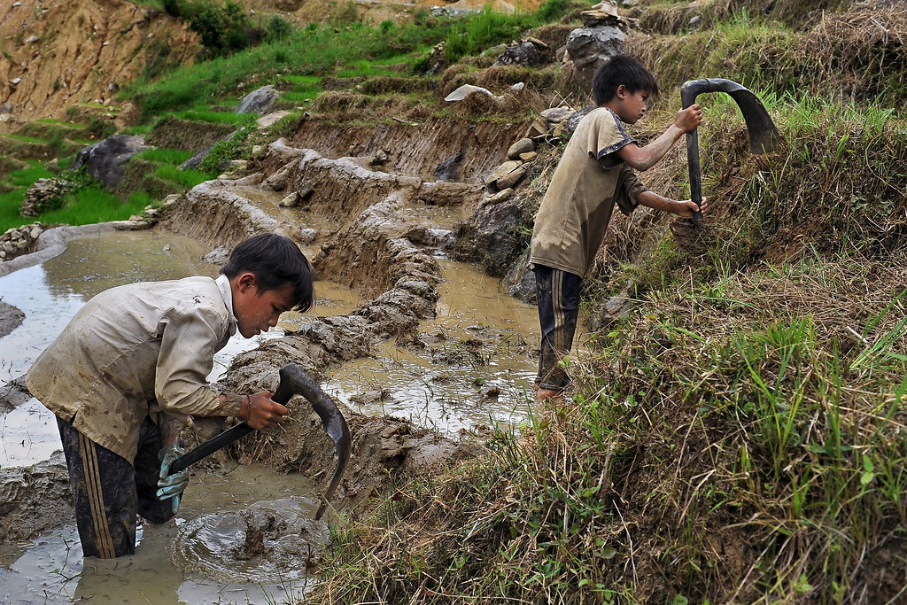
Child labour day
This Photo by Unknown Author is licensed under CC BY-NC-ND

Slide 2
WHAT IS CHILD LABOUR
Child labour is when children are made to work in ways that are harmful to their health, education, or development. It typically involves work that:
Is mentally, physically, socially, or morally dangerous and harmful to children.
Interferes with their schooling, preventing them from attending, forcing them to leave school early, or requiring them to try to combine school with long hours of heavy work.
Examples of Child Labour:
Working in factories or mines.
Being forced to beg or work as street vendors.
Working long hours in agriculture or domestic service.
Engaging in dangerous or illegal activities, like drug trafficking or child soldiering.
What Child Labour Is Not:
Not all work done by children is considered child labour. For example, helping parents at home, working in a family business for a few hours, or doing part-time jobs during school holidays—as long as it is safe and doesn’t interfere with their education and development—is generally considered acceptable.
Why It’s a Problem:
Denies children the right to education.
Harms their physical and mental development.
Often involves exploitation and abuse.
Perpetuates the cycle of poverty.

Slide 3
FORMS OF CHILD LABOUR
Domestic Work
Agricultural Labour
Industrial and Factory Work
Mining and Quarrying
Street Work
Construction Work
Sexual Exploitation and Trafficking
Illicit Activities
Informal Sector Work
Entertainment and Sports

Slide 4
Causes of child labour
Poverty
Lack of Access to Education
Unemployment or Low Wages of Adults
Cultural and Social Norms
Weak Laws and Poor Enforcement
Demand for Cheap Labour
Conflict and Natural Disasters
Family Breakdown
Gender Inequality
Migration

Slide 5
Consequences of Child Labour on Children
Physical Harm-Exposure to dangerous tools, chemicals, or heavy loads.
Leads to injuries, poor growth, and long-term health problems.
Mental and Emotional Stress - Long working hours, pressure, and abuse can cause anxiety, depression, and trauma.
Lack of play or social interaction affects emotional development.
Lack of Education - Many child labourers miss school or drop out entirely.
This limits their future opportunities and traps them in poverty.
Exploitation and Abuse - Children are often underpaid or not paid at all.
Many face verbal, physical, or even sexual abuse in the workplace.

Slide 6
Prevalence of Child Labour
Child labor remains a significant global issue, with an estimated 160 million children engaged in it worldwide. This represents nearly one in ten children globally. While progress has been made in reducing child labor, particularly in Asia and the Pacific, and Latin America and the Caribbean, the overall rate has stagnated since 2016. Sub-Saharan Africa has seen a particularly concerning rise in child labor, with more children in the region working than in the rest of the world combined.
Age and Gender
Most child labourers are between 5–17 years old.
Boys are slightly more likely than girls to be involved overall.
However, girls are more often hidden in domestic work, which is harder to track.

Slide 7
